Slide 1


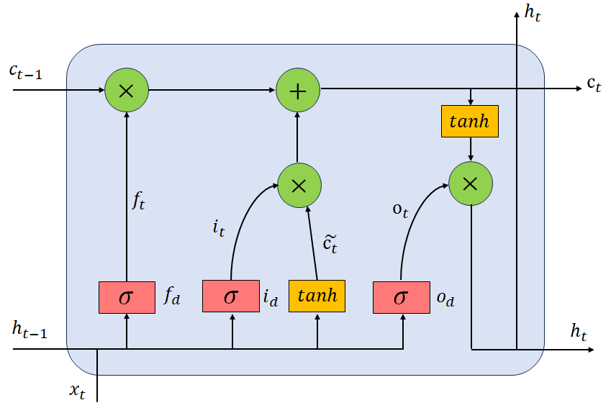
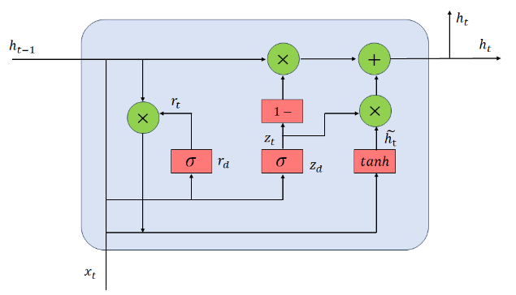
 | Reliability prediction of semiconductor devices based on GRU-LSTM neural network 基于GRU-LSTM神经网络的半导体器件可靠性预测 Shufeng Tang* [唐淑芬], Xuesong Xie [谢雪松] Beijing University of Technology
Background In the semiconductor industry, power electronic systems play a pivotal role in the transmission and conversion of electrical energy in many applications, and semiconductor devices are key components in many applications, widely used in renewable energy generation, hybrid electric vehicles, ships and aviation and other fields. However, semiconductor devices are often the most vulnerable components in most power electronic devices. Due to the complexity of the environment, semiconductor devices often suffer from performance degradation or even failure. Therefore, it is very important to improve and enhance the reliability monitoring of semiconductor devices. If the reliability of semiconductor devices can be evaluated and predicted efficiently, the risk of catastrophic failures during operation can be minimized .At present, the traditional semiconductor device reliability prediction methods are faced with problems such as modeling difficulties, low prediction accuracy and long prediction cycle, but the deep learning based semiconductor device reliability prediction method makes up for the shortcomings of the existing methods, and opens up a new method for the reliability life prediction of semiconductor devices. Reliability prediction model Fig. 1 LSTM neural network unit structure and connection Fig. 2 GRU neural network unit structure and connection In this paper, GRU network and LSTM network are combined to establish a GRU-LSTM neural network. On the one hand, the structure of GRU network model is simplified to contain only two gating units. Fewer state and gating units are stored and updated, which reduces the number of parameters and computational complexity, and enhances the computing speed of GRU model. On the other hand, the LSTM network model can capture the long-term dependencies of time series and transmit the information to the subsequent time steps, effectively dealing with the problem of long-term dependencies. The GRU-LSTM neural network integrates the advantages of the two networks.
Model analysis and life prediction
Fig. 3 Reverse leakage current I_{cbo} degradation curve of 10 bipolar transistors Fig.4 I_{cbo} prediction curve of reverse leakage current of bipolar transistor #2
On this basis, three bipolar transistors were randomly selected from 10 bipolar transistors, and the I_{cbo} degradation trend was predicted by using Data Fitting model, LSTM, GRU and GRU-LSTM models respectively Conclusion In this paper, three transistors were randomly selected from the accelerated degradation test data set of bipolar transistors with constant temperature and humidity stress, and the failure sensitive parameters of the transistors were determined, and the data fitting method, LSTM, GRU and GRU-LSTM were respectively used to predict the I_{cbo} degradation trend of the devices. It is found that the GRU-LSTM neural network model is not only more convenient and accurate than the traditional semiconductor device reliability prediction methods, but also has less prediction error than the LSTM and GRU neural network model, and has lower prediction error and better prediction effect.

Slide 2
海报要求 ①统一字体、颜色：Times New Roman，黑色 ②框架内容一般包含Abstract、Introduction、Methods、Conclusion等； ③以图、表+文字的形式展示，语句精炼，整体饱满； ④保存，命名为“海报代表人姓名+学校/单位”，如：张三+北京工业大学

