Slide 1


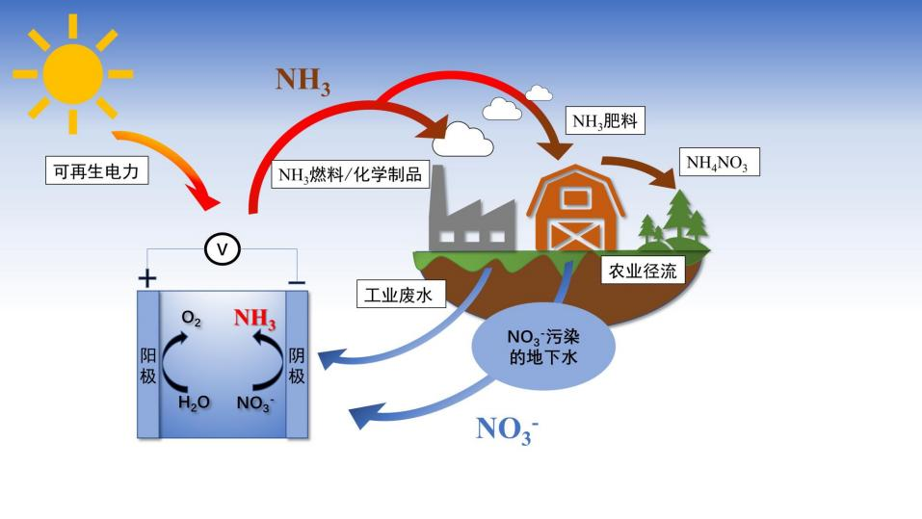
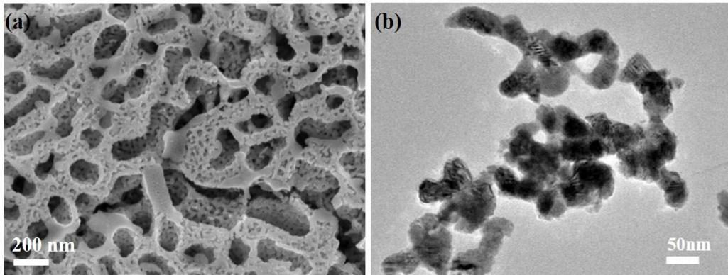
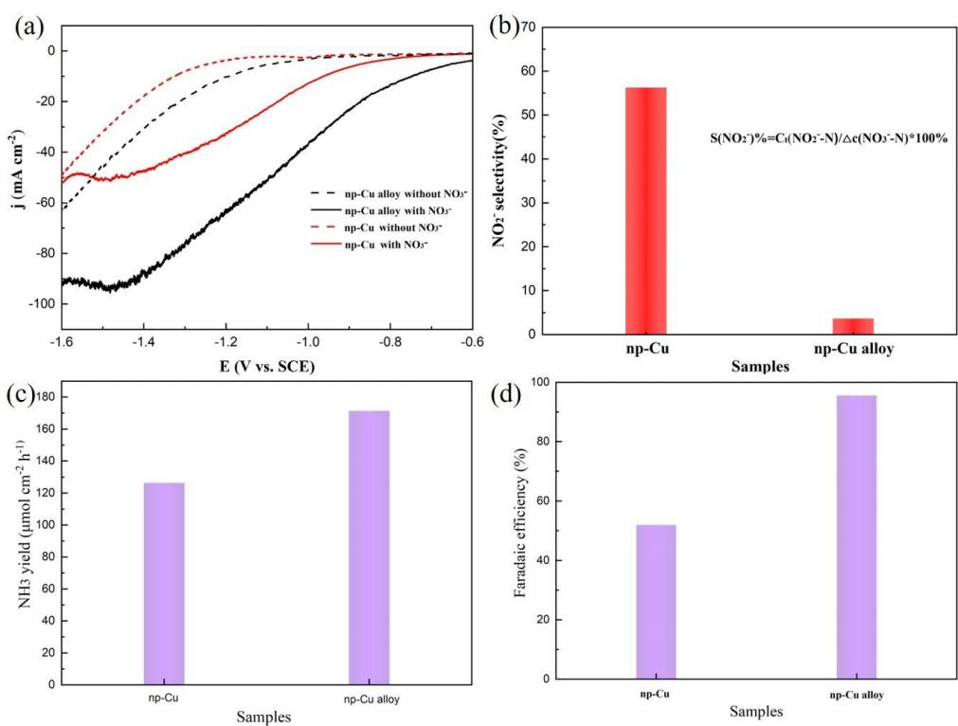
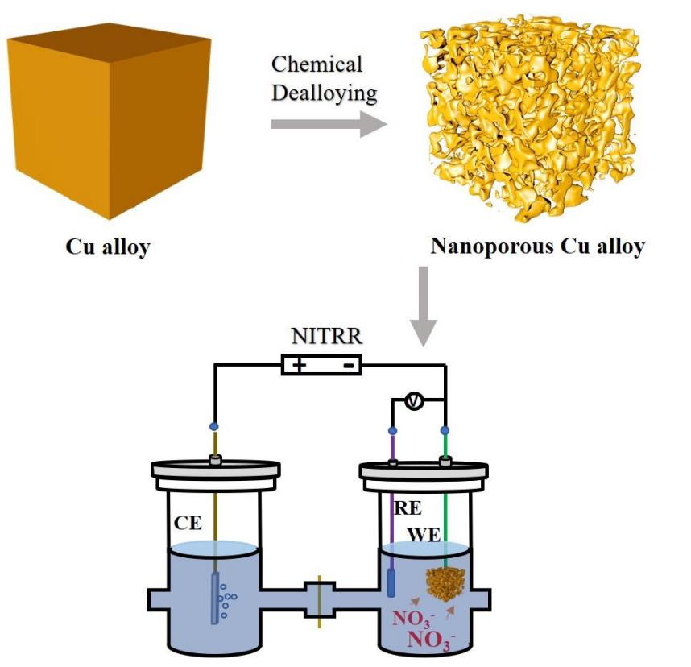
 | XXXXXXXXXXXXXXXXXXXXXXXXXXXXXXXXXX(TITLE) XXX, XXX*, XXX*(NAME) XXX University
XXXXXXX XXXXXXXXXXXXXXXXXXXXXXXXXXXXXXXXXXXX The picture is for reference only, please replace it yourself XXXXXXXXXXXXXXXXXXXXXXXXXXXXXXXXXXXXXXXXXXXXXXXXXXXXXXXXXXXXXXXXXXXXXXXXXXXXXXXXXXXXXXXXXXXXXXXXXXXXXXXXXXXXXXXXXXXXXXXXXXXXXXXXXXXXXXXXXXXXXXXXXXXXXXXXXXXXXXXXXXXXXXXXXXXXX. XXXXXXXXXXXXX Fig. 2 Schematic diagram of preparation of nanoporous Cu alloy catalyst and NITRR
XXXXXXXXXXXXXXXXXX
XXXXXXXXXXXXXXXXXXXXXXXXXXXXX
XXXXXXXXXXXXXXXXXXXXXXXXXXXXXXXXXXXXXXXXXXXXXXXXXXXXXXXXXXXXXXXXXXXXXXXXXXXXXXXXXXXXXXXXXX Conclusion XXXXXXXXXXXXXXXXXXXXXXXXXXXXXXXXXXXXXXXXXXXXXXXXXXXXXXXXXXXXXXXXXXXXXXXXXXXXXXXXXXXXXXXXXXXXXXXXXXXXXXXXXXXXXXXXXXXXXXXXXXXXXXXXXXXXXXXXXXXXXXXXXXXXXXXXXXXXXXXXXXXXXXXXXXXXXXXX

